Slide 1
Virtual Reality developer
checked by : t.bekbulatov
Done by : Sh.botabek

Slide 2
Content:
Introduction
World in the vr
Who is vr developer?
Important qualities
JOB dis/satisfaction factors
possibility of helmets
Microsoft hololens
Opportunity of hololens
conclusion

Slide 3


Slide 4
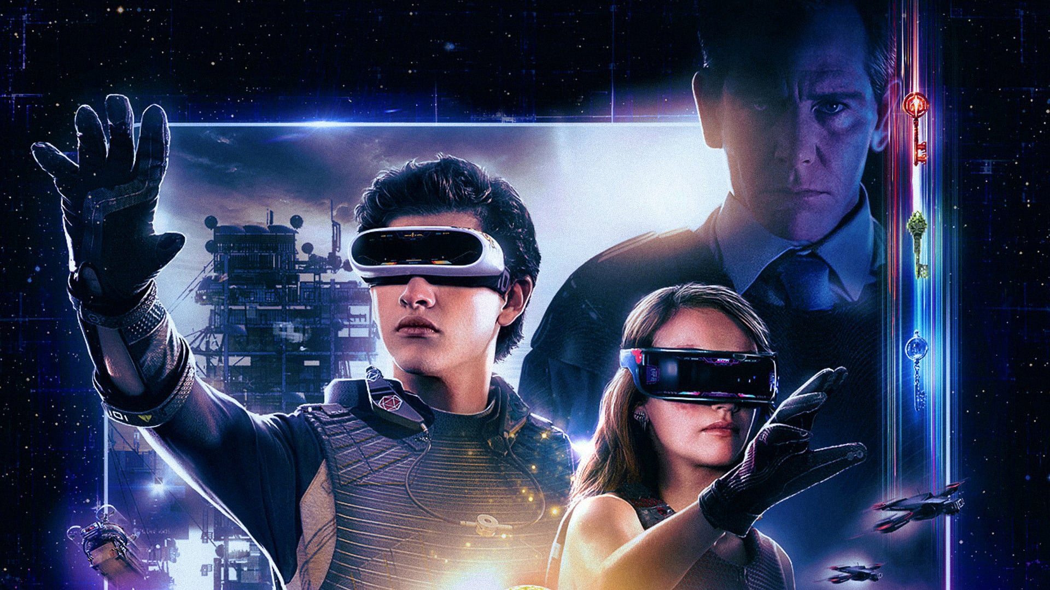
World in the VR

Slide 5
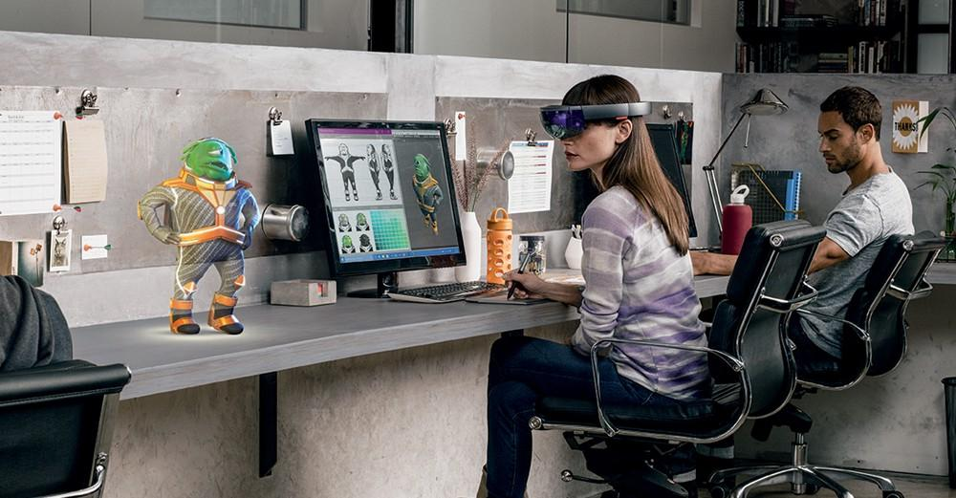
Who is vr developer?
The developer of VR products is a virtual reality programmer, architect who creates a spectacular virtual space. Augmented and virtual reality technologies for creating a new world are used not only in the gaming and film industry, but also in construction, architecture, design, education, trade, and for medical purposes.

Slide 6

Necessary qualities that a developer must possess:
rich imagination;
visualization ability;
boundless fantasy;
psychological education with knowledge of the intricacies of the human psyche and psychology;
creativity;
flexibility of thinking;
result orientation;
a responsibility;
independence.

Slide 7
JOB dis/satisfaction factors
Job satisfaction factors:
Demand for the profession;
High salary;
An interesting and creative profession.
Job dissatisfaction factors:
Difficulty in learning, no special profession in educational institutions;
Irregular working hours.

Slide 8


Slide 9
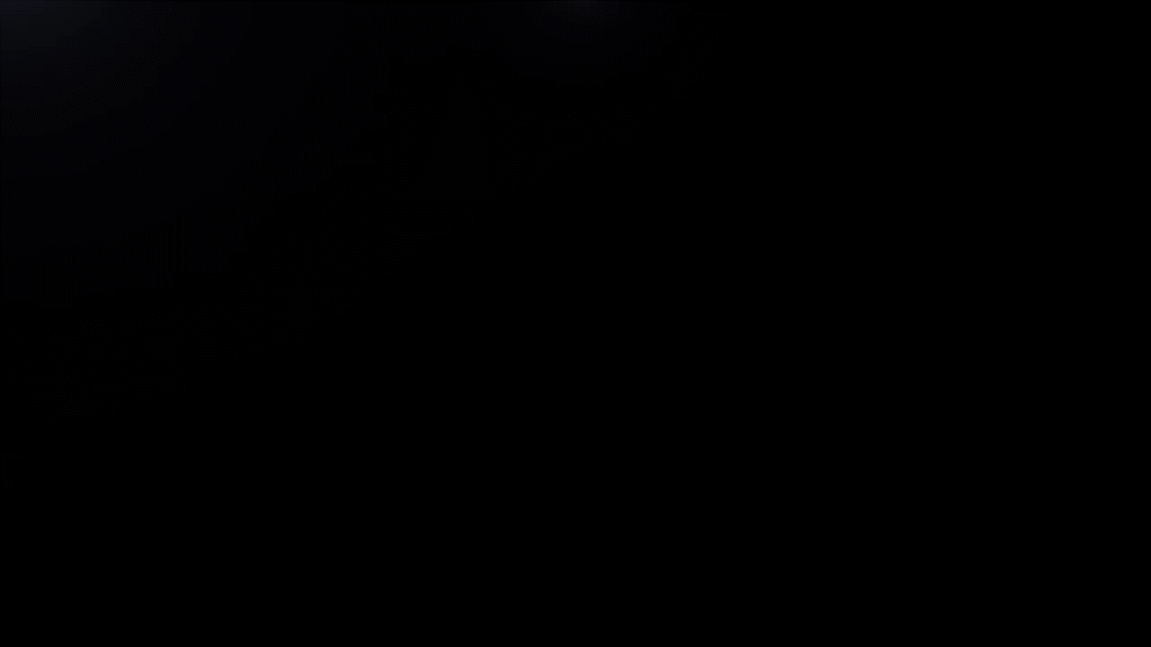

Slide 10
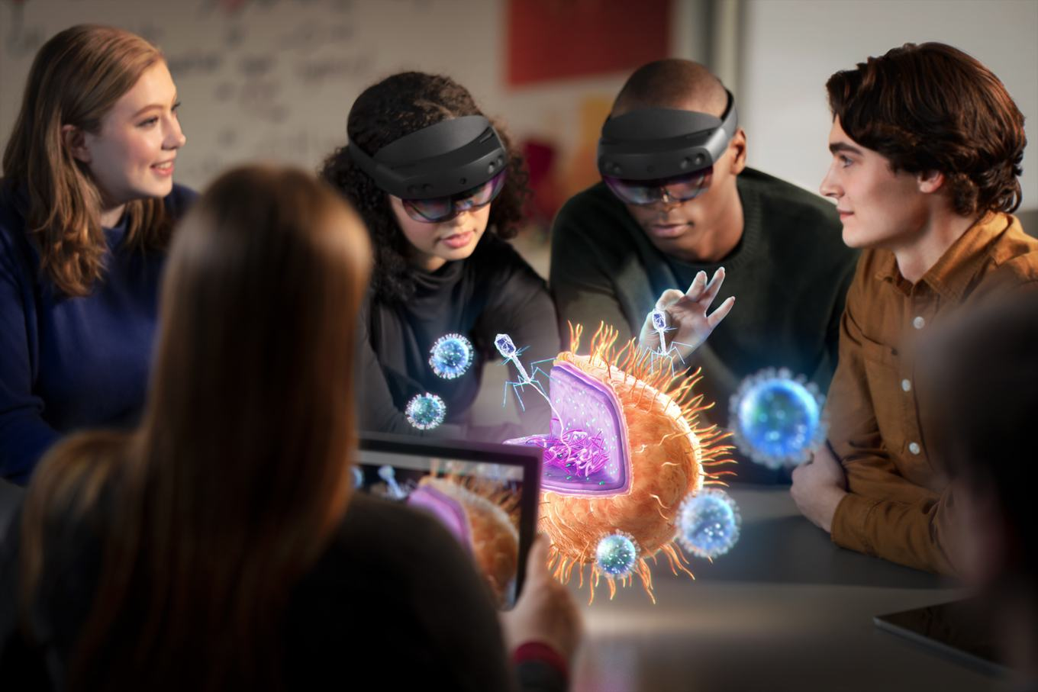
you can discuss study with your friends

Slide 11
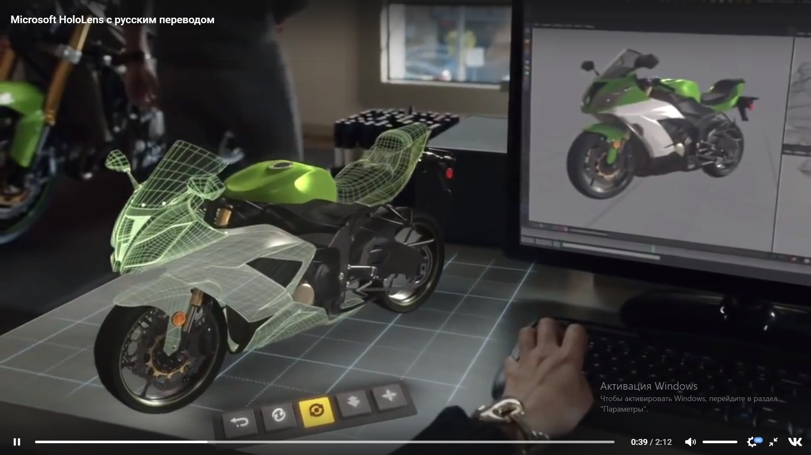
do you want to be a designer?

Slide 12
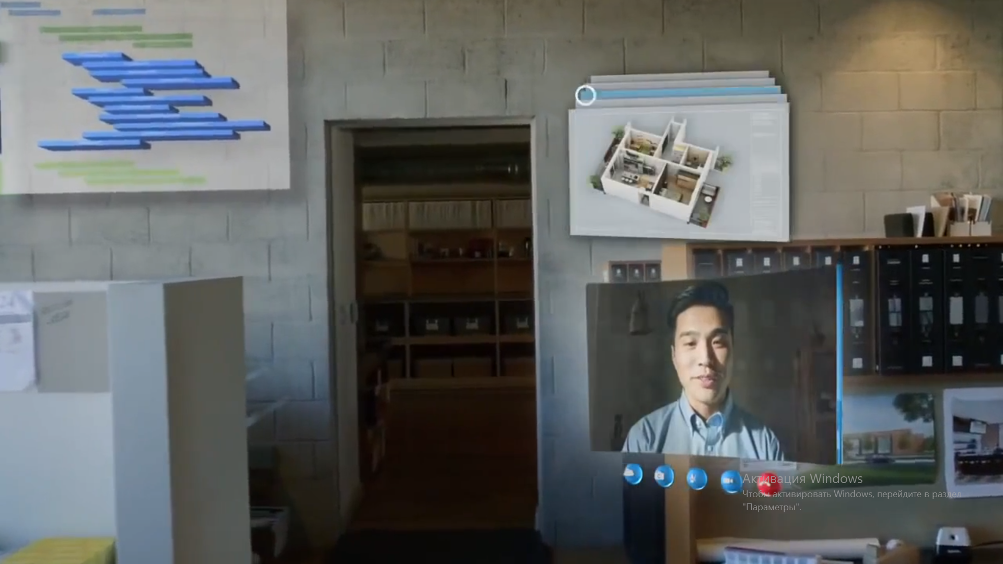
you can chat with friends using video call

Slide 13
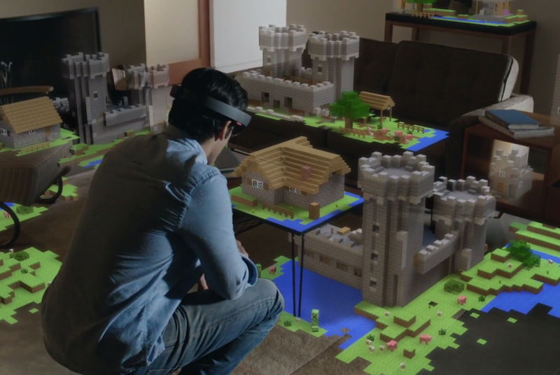
build your perfect home

Slide 14
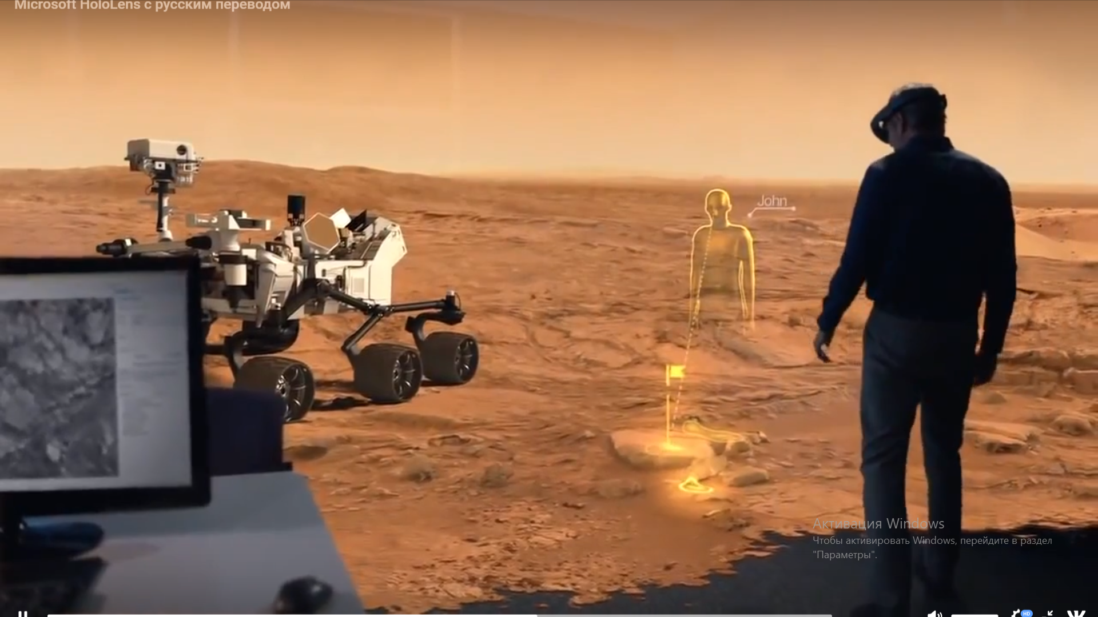
you can visit mars

Slide 15
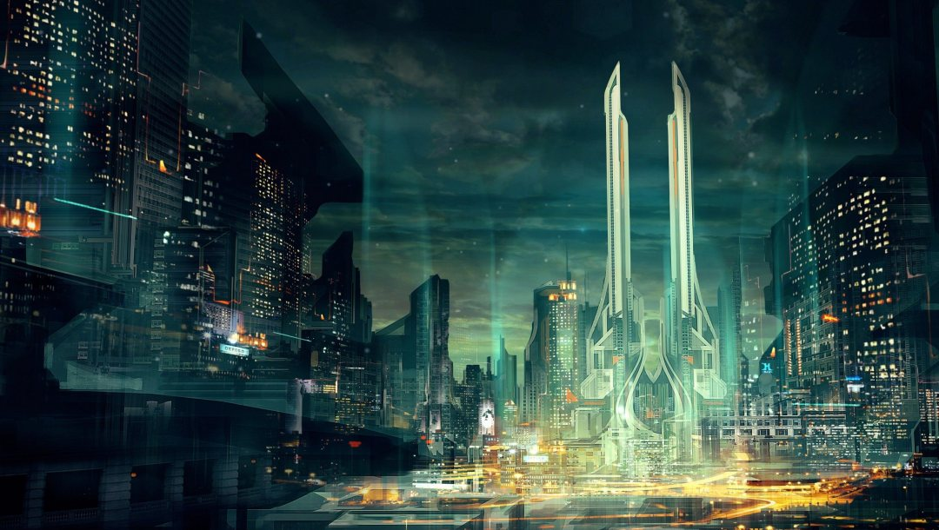
The future of vr developer
The profession of a VR product developer will become a separate profession in 2-3 years. By that time, augmented or virtual reality technologies will become an everyday part of the life of all people. The profession itself is so multifunctional and comprehensive that career development in it will be the continuous improvement of technical skills and socio-psychological aspects. Representatives of the Center for the Development of Technology Companies, and representatives of Crytek are confident that the future lies in virtual reality (however, not only they think so). But if there is already interest on the part of developers, then the user audience will become interested in virtual and augmented reality in 5-10 years, when there will be many mass products on the market and this way of interacting with the world will become popular.

Slide 16
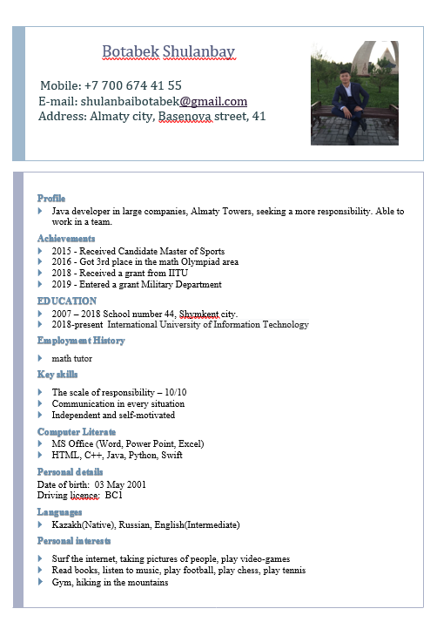
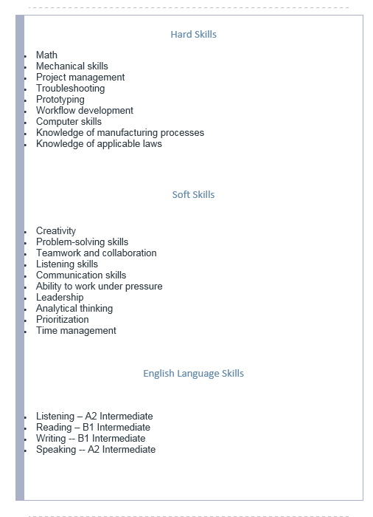

Slide 17
- Our VR helmet costs only 3000 $ - If you have questions please contact this number:+7777 703 05 01 - the addresses of our site: https://www.youtube.com/watch?v=eqFqtAJMtYE https://hi-news.ru/tag/hololens https://www.youtube.com/watch?v=cSp1dM2Vj48 https://46c4ts1tskv22sdav81j9c69-wpengine.netdna-ssl.com/wp-content/uploads/sites/43/2015/11/Volvo-Cars-Microsoft-HoloLens-experience_01.jpg https://logos-download.com/wp-content/uploads/2016/02/Microsoft_logo_hololens.png

Slide 18
Attention attention attention Thank you for your attention

